Slide 1
Electronic Structure Theory

Slide 2
“Scientific knowledge is as much an understanding of the diversity of situations for which a theory or its models are relevant as an understanding of its limits”
– Elinor Ostrom, Governing the Commons

Slide 3
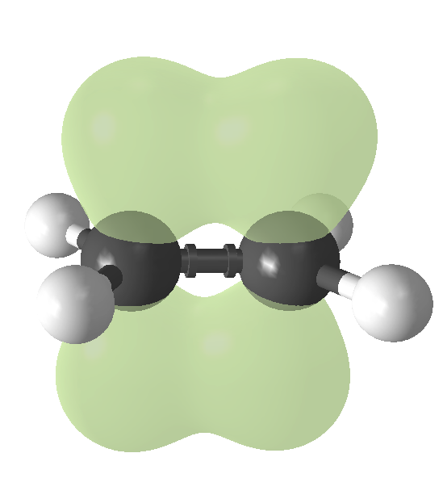
What is Electronic Structure Theory
Determination of location and structure of electrons within a molecule
σ*
1s
1s
σ

Slide 4
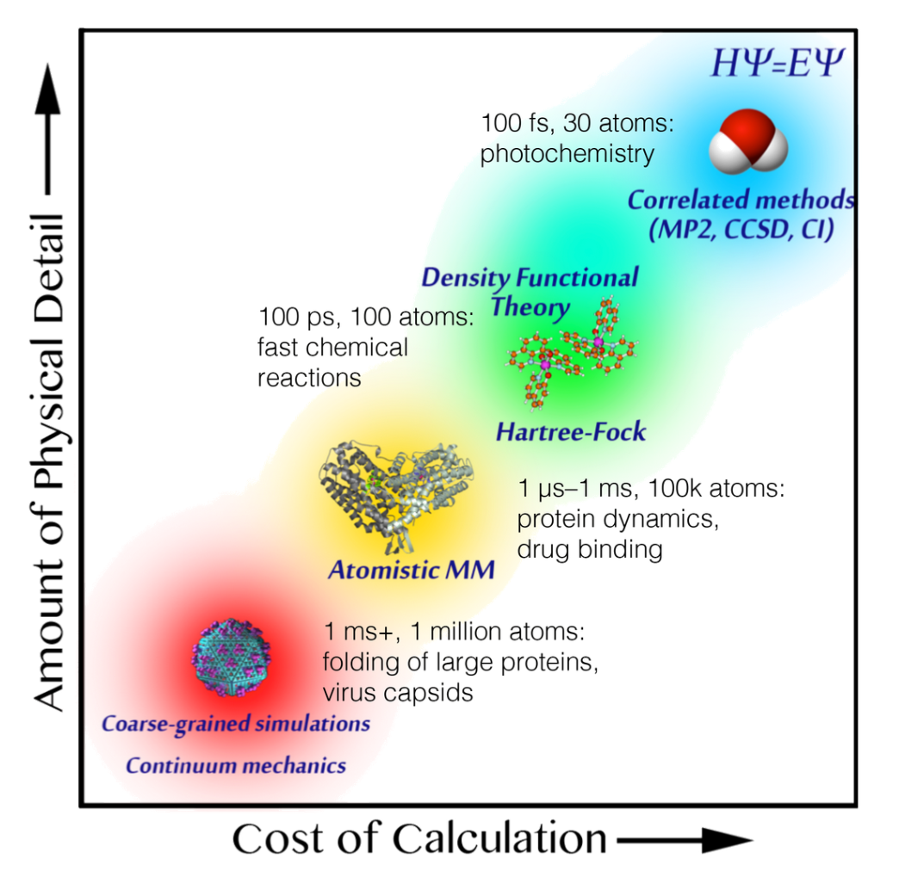
Quantum vs. Classical Calculations
The model you choose depends on what you want to calculate
“All models are wrong, some are useful”
Classical: no electronic properties, fast
Quantum: more accurate, more properties, slow

Slide 5
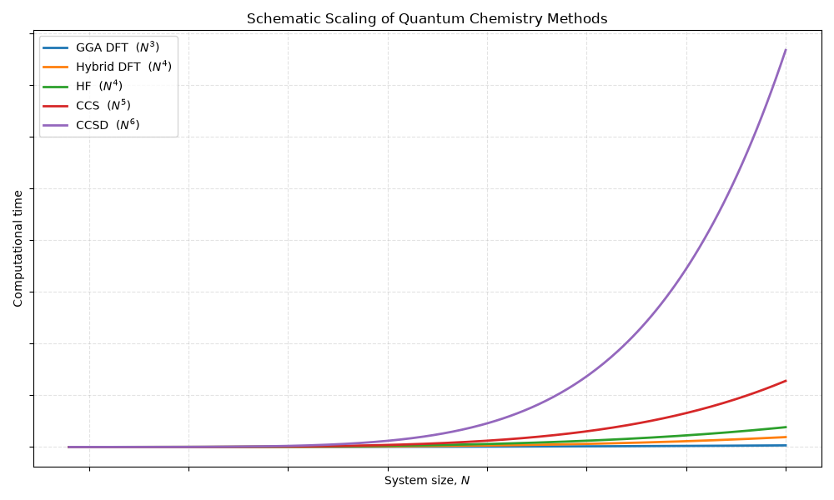

Slide 6
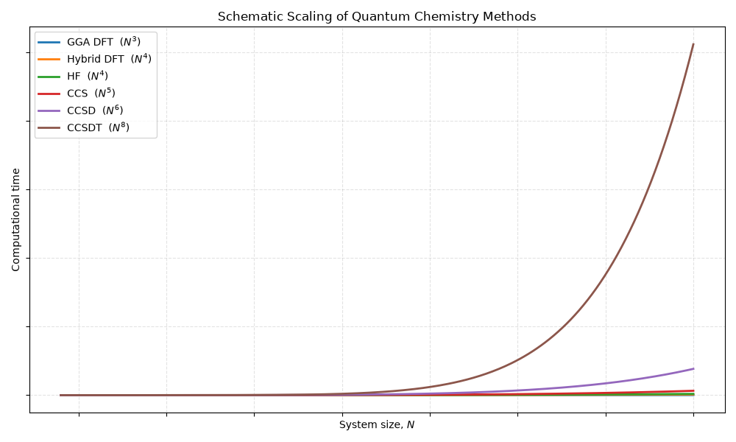

Slide 7
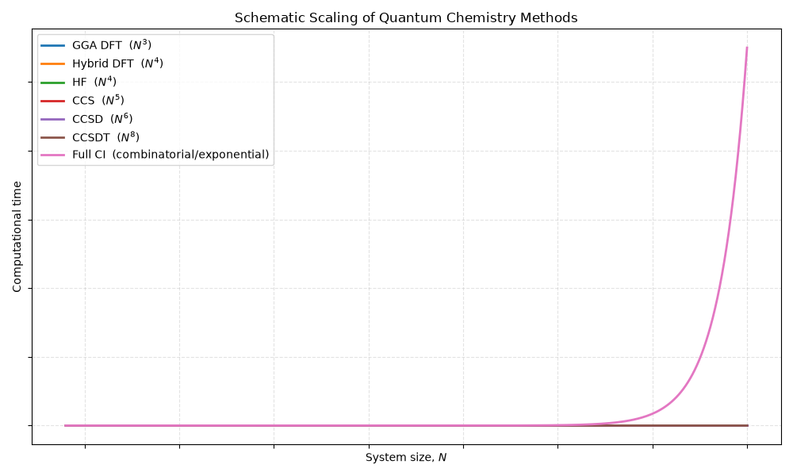

Slide 8
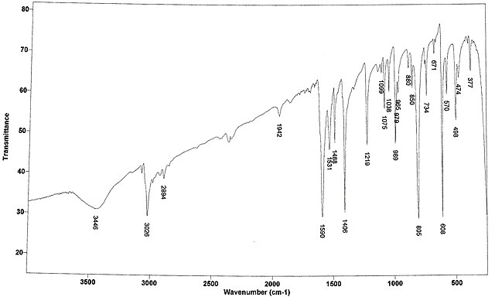
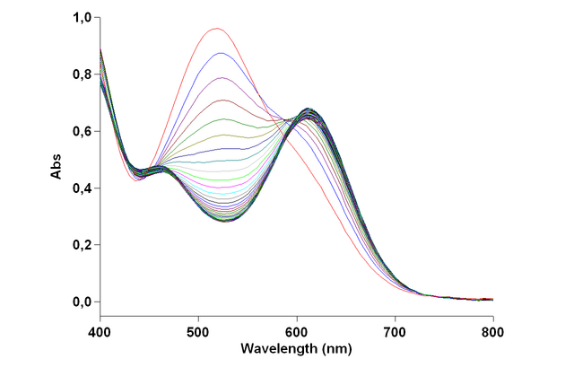
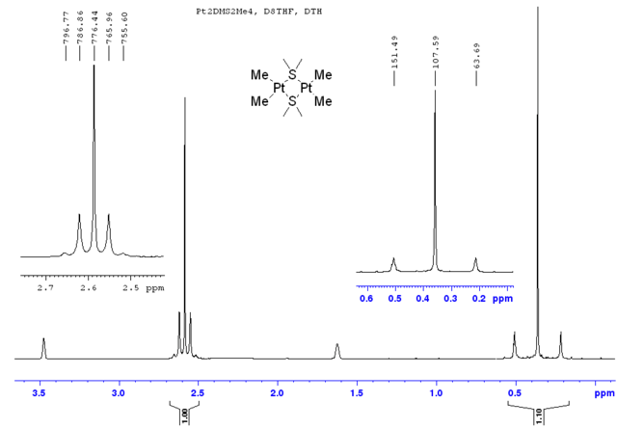
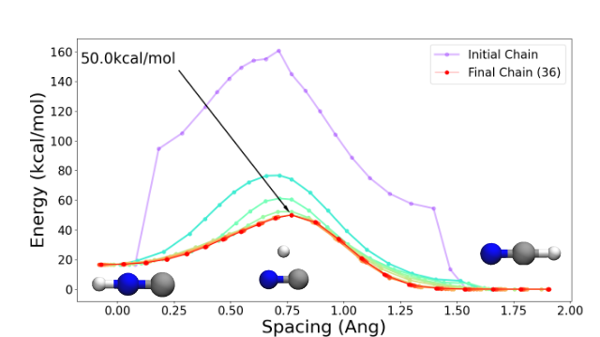
Singlepoint Calculations
Calculation on a single fixed geometry
Electronic properties:
  UV/Vis, IR, CD spectra
  NMR/Magnetic susceptibility
  Bonding information
  Reaction energies/Transition states

Slide 9
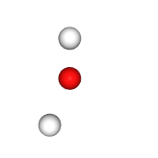
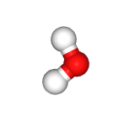
Geometry Optimization
O 0.0000 0.0000 0.0000
H 0.0000 1.5875 0.0000
H 0.7938 -1.8521 0.0000
O -0.1282 -0.1662 0.0000
H 0.3142 0.6933 0.0000
H 0.7087 -0.7918 0.0000

Slide 10
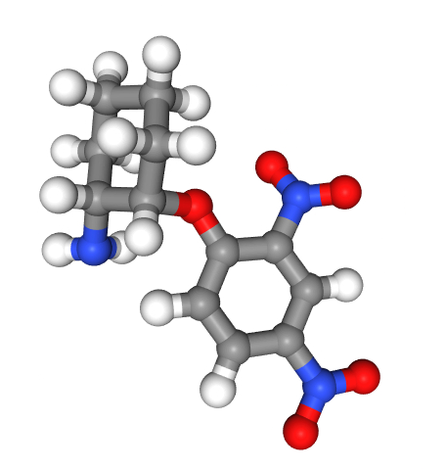
Why not use QM for everything?
Geometry optimization of this molecule took 7 hours on two cores (psi4, ωB97x/6-31G*)

Slide 11
QM Model Selection
Molecular Orbitals (MOs) are expanded in the basis of Atomic Orbitals (AOs). These AOs are defined by your basis set
Your method defines how you are calculating those MOs (what approximations)
Combined, these are referred to as your model, model chemistry, or level of theory
Often written together with a slash, with the method first
Method (Hartree-Fock)
hf/sto-3g
b3lyp/6-31g*
pbe/def2-SVP
ccsd(t)/aug-cc-pvdz
Basis set
(Slater type orbital fit with 3 gaussians)

Slide 12
Method Hierarchy
There is a zoo of methods, all with their strengths and weaknesses
Hartree-Fock (HF) – very basic, but inaccurate relative to others (lacks correlation)
Møller–Plesset perturbation theory (MP2, MPn) – Adds correlation
Coupled Cluster (CCS, CCSD, CCSD(T)) – Very accurate, very expensive
Density Functional Theory (DFT) – Very good balance between accuracy and cost
  Walter Kohn – 1998 Nobel Prize in Chemistry for the development of DFT
Composite methods (do several at once & extrapolate)
And now machine learning!

Slide 13
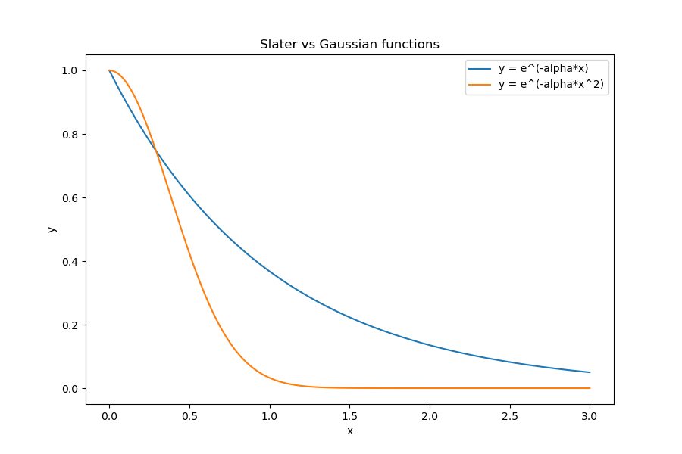
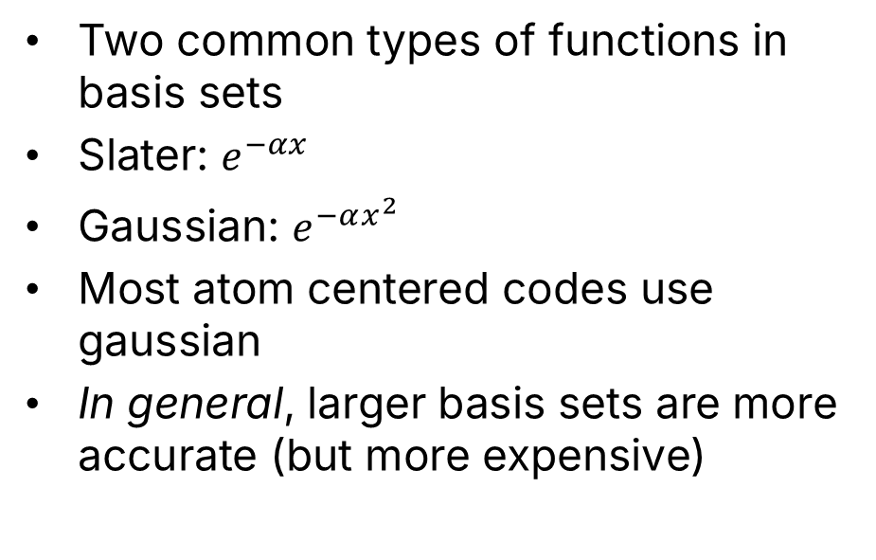
Basis Sets
Two common types of functions in basis sets
Slater: $e^{−αx}$
Gaussian: $e^{−αx^{2}}$
Most atom centered codes use gaussian
In general, larger basis sets are more accurate (but more expensive)
https://www.basissetexchange.org

Slide 14
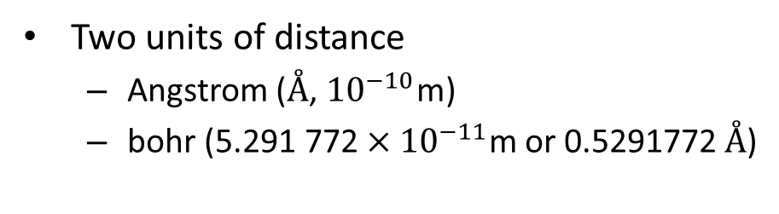
Molecules
In QM, we generally only care about:
  Element (number of protons - Z)
  Coordinates
  Charge & multiplicity (unpaired electrons)
Two units of distance
  Angstrom (Å, ${10}^{−10}$m)
  bohr (${\text{5.291 772}×10}^{−11}$m or 0.5291772 Å)
Bonds do not exist in the QM input world
O 1.548014347149 0.000000000000 0.060071441686
H 0.548241218221 0.000000000000 0.038771425885
H 1.819295099755 0.000000000000 -0.902428819751

Slide 15
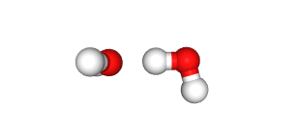
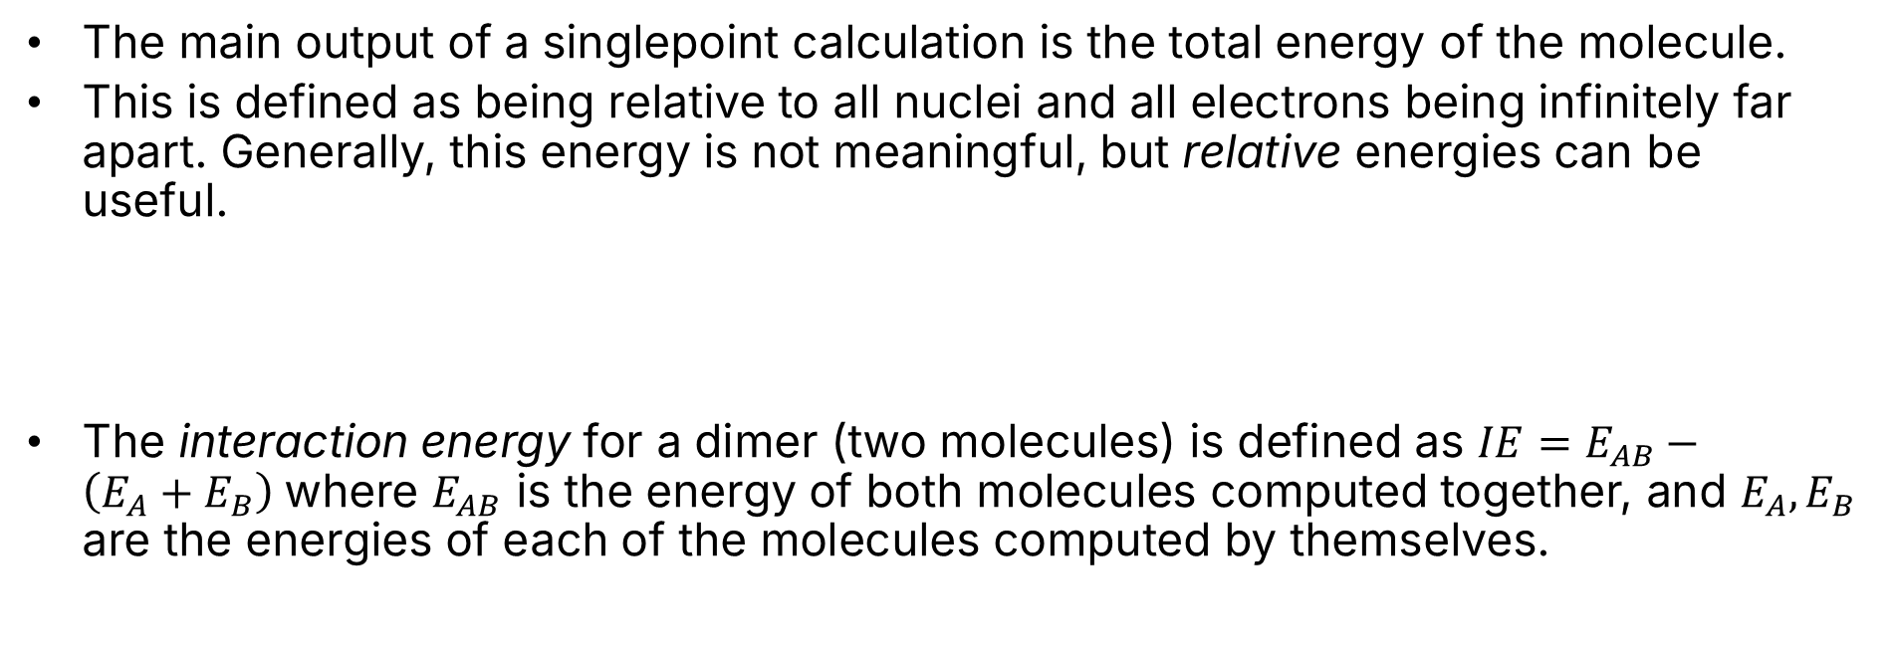
Interaction Energy
The main output of a singlepoint calculation is the total energy of the molecule.
This is defined as being relative to all nuclei and all electrons being infinitely far apart. Generally, this energy is not meaningful, but relative energies can be useful.
The interaction energy for a dimer (two molecules) is defined as $IE=E_{AB}−\left(E_{A}+E_{B}\right)$where $E_{AB}$ is the energy of both molecules computed together, and $E_{A}, E_{B}$ are the energies of each of the molecules computed by themselves.

